Slide 1

Your extension object
(The word “hyperCube” is confusing so we use a cute cat to represent “hyperCube”)

Slide 2
Your extension object
Your extension object

Slide 3
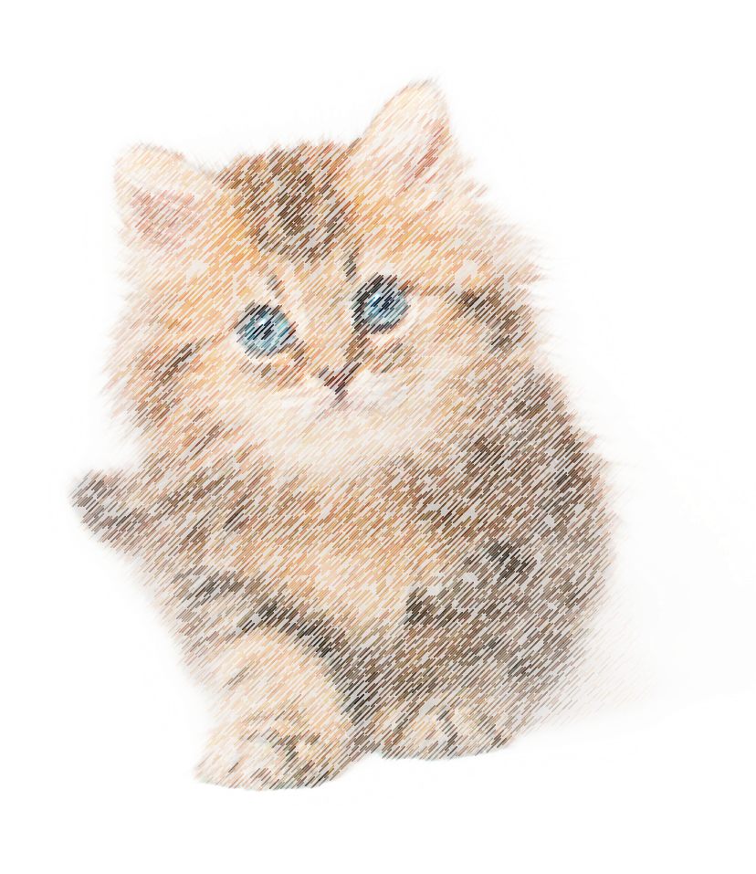
Backend Qix engine
Your extension object

Slide 4

extension object a
Your extension object
extension object b
Backend
extension object c

Slide 5
extension object a
meow
Your extension object
extension object b
Backend
extension object c

Slide 6
extension object a
meow
meow
Your extension object
extension object b
Backend
extension object c

Slide 7
extension object a
meow
meow
Your extension object
meow
extension object b
meow
extension object c
meow

Slide 8

Your extension object
Data page

Slide 9

Your extension object
Data page

Slide 10
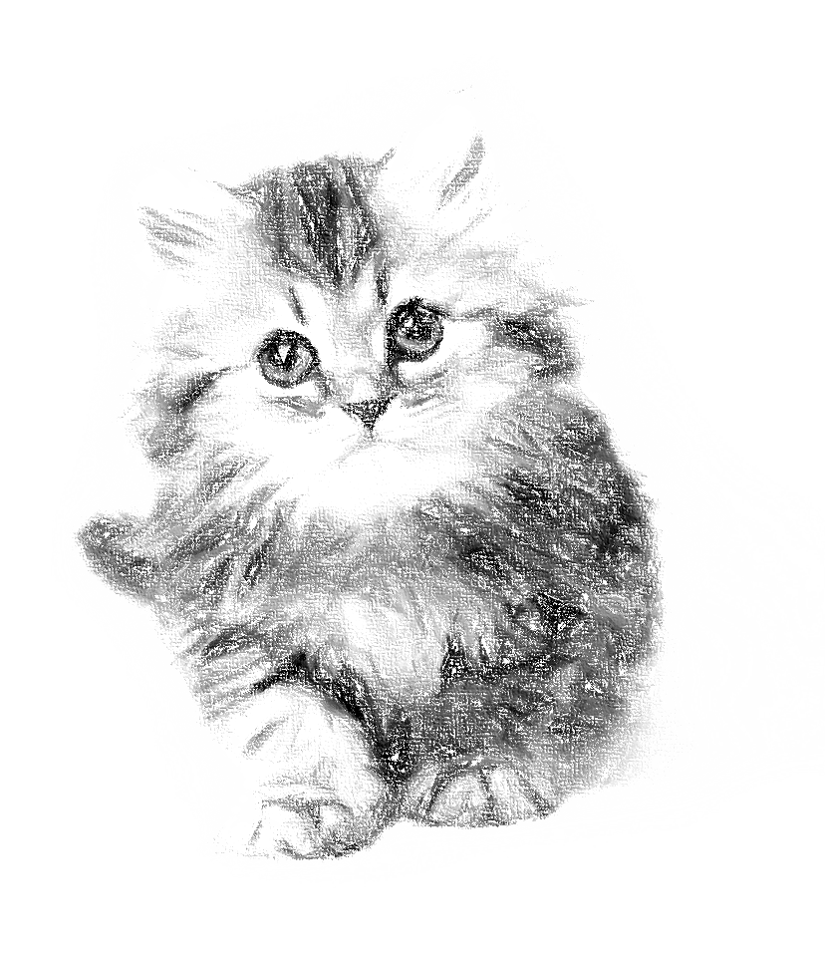
Your extension object

Slide 11
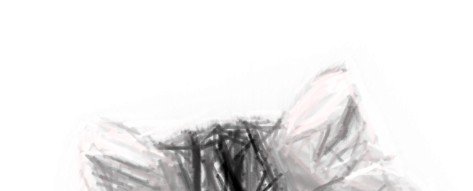
Your extension object

Slide 12
Your extension object

Slide 13
Your extension object

Slide 14


Your extension object

Slide 15


Slide 16


Slide 17
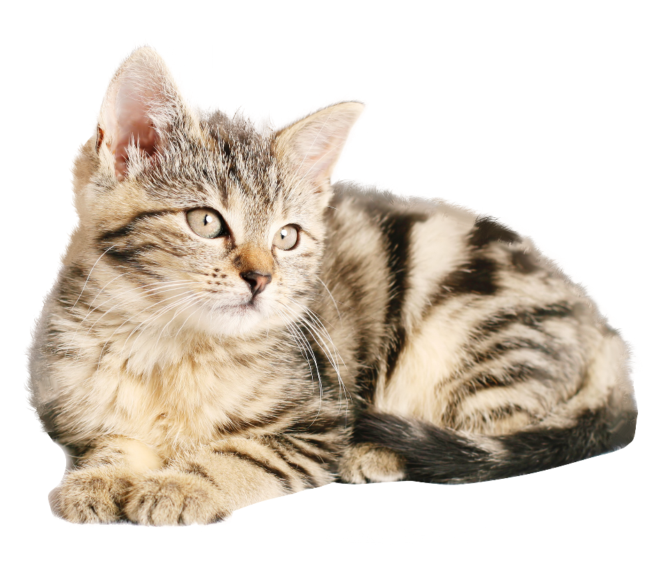




Slide 18
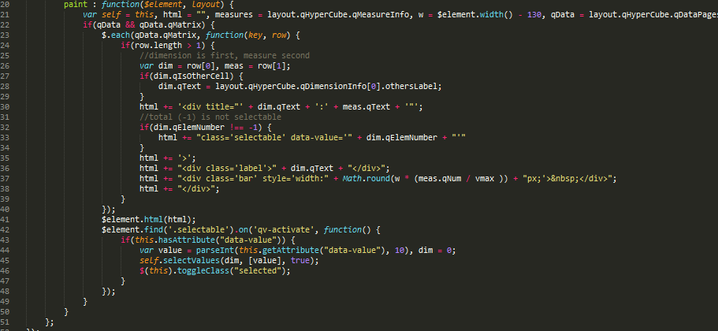

Slide 19
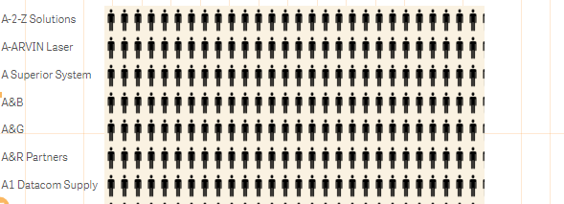

Slide 20

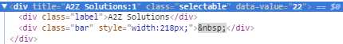
………………….
………………….
………………….

Slide 21
………………….
………………….

Slide 22
………………….
If dimension exist->
create a new div named dimension:measure with class=‘selectable’ and property data-value

Slide 24
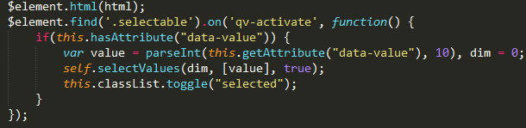
Look for all element with class “selectable”, when “qv-activate” event triggers ->
If “data-value” attribute is available ->
Take value of “data-value” element and call backendAPI.selectValue method to perform a selection ->
Toggle selection attribute

